Slide 1
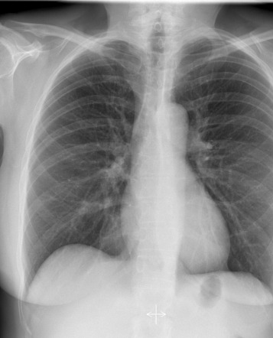
Team 7:
Do We Need Personalization and Big Data?
Yi Ge
Sadia Afreen
Francis Tuluri
Juan Luis Santana
Mentors:
Jack Gallifant and Po-Chih Kuo
Samra SR et al. Assessment of acute pulmonary embolism outcome in hospital through Tricuspid Annular Plane Systolic Excursion versus Pulmonary Embolism Severity Index score. Egyptian Journal of Chest Disease and Tuberculosis. 2017: 66(4): 663-669.

Slide 2

Problem definition
Can personalization with group attributes improve the performance at a group level?
How does personalization affect subgroup performance compared to generic models?
Fair Use- Personalised models should result in improved performance to predict no finding across all subgroups compared to the generic model
Notes:
‘overall performance’ v.s. ‘subgroup performance’

Slide 3

Dataset
Emory CXR dataset
CXR Images
datathon_cxr_metadata.csv
datathon_cxr_findings.csv
Demographic features: sex, age, race
70% training, 30% testing
7,548 images from 1,000 patients

Slide 4
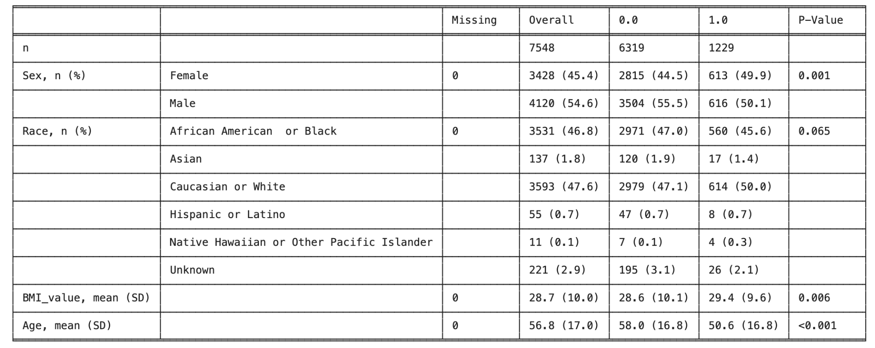
Table 1
47.6% White, 46.8% African American
45.4% Female, 54.6% Male
No Findings

Slide 5

Models
Association with demographics alone
Densenet 121-> create embedding + probability of no finding
Random forest with additional features
age
sex
race
Evaluated subgroup performance on each combination
AUC
Personalization gain
Best/worst change in subgroup
Ratio gain/violation

Slide 6
Results
Features | Accuracy | F1 Scores
Age | 0.72 | 0.80
Age, Race_White | 0.73 | 0.80
Age, Race_White, Race_Black | 0.74 | 0.80
Age, Race_White, Race_Black, Sex_Male | 0.73 | 0.80
Age, Race_White, Race_Black, Sex_Male, BMI Value | 0.86 | 0.87
Age, Race_White, Race_Black, Sex_Male, BMI Value, Insurance | 0.87 | 0.88

Slide 7

Results
Overall = 0.544
Age
-Young (<72) | 0.537
-(Old) (>72) | 0.585
Sex
-Male | 0.529
-Female | 0.568
Race
-(White) | 0.550
-Non-(White) | 0.537
-(Black) | 0.527
-Non-(Black) | 0.560
AUC of baseline model (NN) using only CXRs

Slide 8
Results
 | NN +Age | NN +Male | NN +White | NN +Black | NN +Age +Male | NN +Age +White | NN +Age +White | NN +White +Male
AUC | 0.537 | 0.530 | 0.536 | 0.528 | 0.531 | 0.558 | 0.557 | 0.545
AUC gain | -1.3% | -2.6% | -1.5% | -2.9% | -2.4% | +2.6% | +2.4% | +0.2%
Best gain (Best group) | +3.4% (Black) | +2.9 (White) | +2.1 (Black) | +1.5 (Black) | +2.2 (White) | +9.5 (Black) | +3.6 (Black) | +2.9 (White)
Worst gain (Worst group) | -12.5% (Old) | -7.5% (Non-White) | -8.7% (Old) | -7.9% (Old) | -20.5% (Old) | -6.0% (Old) | -3.8% (Old) | -3.9% (Old)
Ratio gain/viol | 3/5 | 2/6 | 1/7 | 1/7 | 1/7 | 5/3 | 6/2 | 4/4
Notes:
‘column_names’: ['Baseline', 'NN_Age', 'NN_Male', 'NN_(White)', 'NN_(Black)', 'NN_Age_Male', 'NN_Age_(White)', 'NN_Age_Male_(White)', 'NN_(White)_Male']
'overall_performance': [0.544,0.537,0.530,0.536,0.528,0.531,0.558,0.557,0.545]
‘overall_performance_change’: [ 0. , -1.3, -2.6, -1.5, -2.9, -2.4, 2.6, 2.4, 0.2]
'best/worst subgroup changes': [{3.4, -12.5},
{2.9, -7.5},
{2.1, -8.7},
{1.5,-7.9},
{2.2,-20.5},
{9.5,-6.0},
{3.6,-3.8},
{2.9,-3.9}]
'best/worst subgroup': ['{(Black)=1}, {Age=1}',
'{(White)=1}, {(White)=0}',
'{(Black)=1}, {Age=1}',
'{(Black)=1}, {Age=1}',
'{(White)=1}, {Age=1}',
'{(Black)=1}, {Age=1}',
'{(Black)=1}, {Age=1}',
'{(White)=1}, {Age=1}']
fairuse_ratio = [3/5, 2/6, 1/7, 1/7, 1/7, 5/3, 6/2, 4/4]

Slide 9

Discussion
Personalization may result in overall performance boost
Personalization does not always result in benefits to subgroups
Future work
Fine tuning
Other diagnoses
Other models
External validation

Slide 10
Summary- Do We Need Personalization and Big Data?
Fair Use- Personalised models should result in improved performance to predict no finding across all subgroups compared to the generic model
Evaluation of Image embedding + Random forest with additional features
 | NN +Age | NN +Male | NN +White | NN +Black | NN +Age +Male | NN +Age +White | NN +Age +White | NN +White +Male
AUC | 0.537 | 0.530 | 0.536 | 0.528 | 0.531 | 0.558 | 0.557 | 0.545
AUC Gain | -1.3% | -2.6% | -1.5% | -2.9% | -2.4% | +2.6% | +2.4% | +0.2%
Best Gain (Best Group) | +3.4% (Black) | +2.9 (White) | +2.1 (Black) | +1.5 (Black) | +2.2 (White) | +9.5 (Black) | +3.6 (Black) | +2.9 (White)
Worst Gain (Worst Group) | -12.5% (Old) | -7.5% (Non-White) | -8.7% (Old) | -7.9% (Old) | -20.5% (Old) | -6.0% (Old) | -3.8% (Old) | -3.9% (Old)
Ratio gain/viol | 3/5 | 2/6 | 1/7 | 1/7 | 1/7 | 5/3 | 6/2 | 4/4

Slide 11
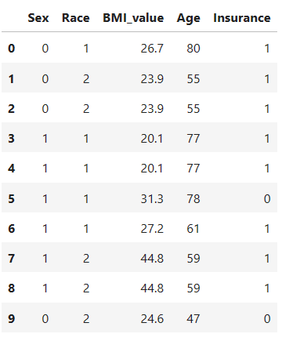
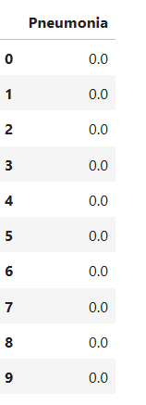
Results: Random Forest Model
Features and target

Slide 12
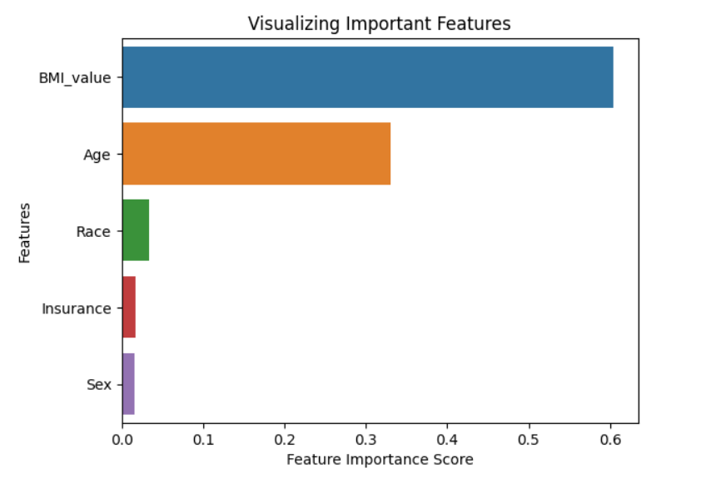
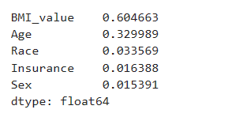
Results: Random Forest Model
100 trees; Feature importance

Slide 13
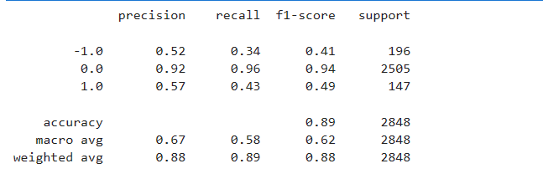
Results: Random Forest Model
100 trees; Metrics

